Slide 1
Title: Capstone on Analyzing Booking Trends in the Hospitality Industry Subtitle: A Predictive Model to Determine Customer Booking Status Presented by: STANLEY SEWE SEPAGA Date: October 2025

Slide 2
Problem Statement: The hotel struggles with high cancellation rates, leading to lost revenue and inefficient resource allocation. The existing system does not provide sufficient insights into why customers cancel their bookings. The hotel management seeks to predict cancellations based on booking data to improve operational efficiency and customer retention.

Slide 3
Objectives:
1. Analyzing booking patterns to uncover the underlying reasons why customers cancel their bookings.
2. By examining variables like lead time, room type, market segment, and price, the project allows the identification of specific factors that influence customers' decisions to either cancel or keep their bookings.
3. Optimizing customer Satisfaction, By minimizing cancellations, the hotel can ensure better resource allocation and improved guest experience. Customers who are less likely to cancel will contribute to smoother operations and increased satisfaction.

Slide 4
DESCRIPTIVE STATISTICS
 | number of adults | number of children | number of weekend nights | number of week nights | car parking space | lead time | repeated | P-C | P-not-C | average price | special requests
count | 36285.0 | 36285.0 | 36285.000000 | 36285.000000 | 36285.000000 | 36285.000000 | 36285.000000 | 36285.000000 | 36285.000000 | 36285.000000 | 36285.000000
mean | 2.0 | 0.0 | 0.810087 | 2.178145 | 0.030977 | 83.767893 | 0.025630 | 0.023343 | 0.153369 | 102.968399 | 0.619733
min | 2.0 | 0.0 | 0.000000 | 0.000000 | 0.000000 | 0.000000 | 0.000000 | 0.000000 | 0.000000 | 20.750000 | 0.000000
25% | 2.0 | 0.0 | 0.000000 | 1.000000 | 0.000000 | 17.000000 | 0.000000 | 0.000000 | 0.000000 | 80.300000 | 0.000000
50% | 2.0 | 0.0 | 1.000000 | 2.000000 | 0.000000 | 57.000000 | 0.000000 | 0.000000 | 0.000000 | 99.450000 | 0.000000
75% | 2.0 | 0.0 | 2.000000 | 3.000000 | 0.000000 | 126.000000 | 0.000000 | 0.000000 | 0.000000 | 120.000000 | 1.000000
max | 2.0 | 0.0 | 5.000000 | 6.000000 | 1.000000 | 289.500000 | 1.000000 | 13.000000 | 58.000000 | 179.550000 | 5.000000
std | 0.0 | 0.0 | 0.867286 | 1.290708 | 0.173258 | 81.662186 | 0.158032 | 0.368281 | 1.753931 | 31.678904 | 0.786262

Slide 5
Brief insights drawn from the summary statistics:
From weekend nights, mean =0.8 and median =1 implies most guest stay 1 weekend night.
From week nights, mean = 2, mean =2.2 implies typical stays are 2 weekday nights.
OVERALL: This reveals stays are short
On Lead time, mean=84 and median=57 reveals guests book about 2 months in advance.
On parking lots, mean = 0.03 and median =0, reveals that almost no guest use parking lots.

Slide 6
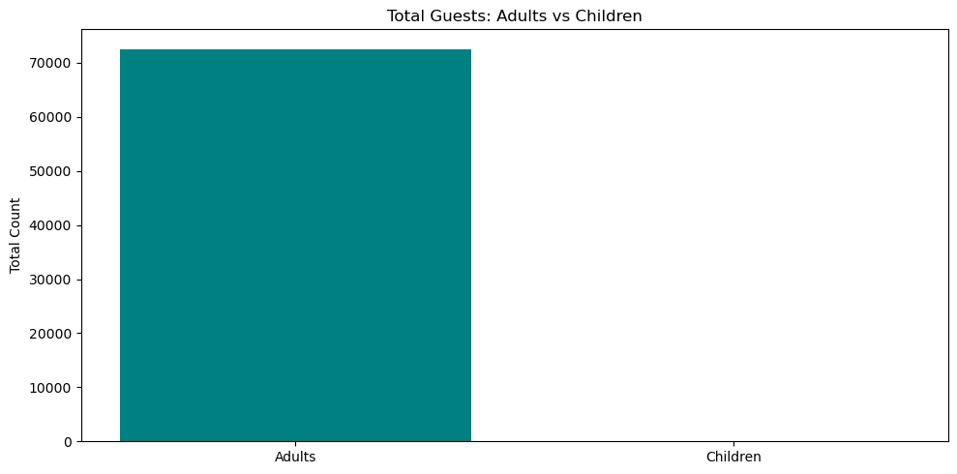
Getting a brief overview of our customer base:
Our data reveals that our customer base is only adults

Slide 7
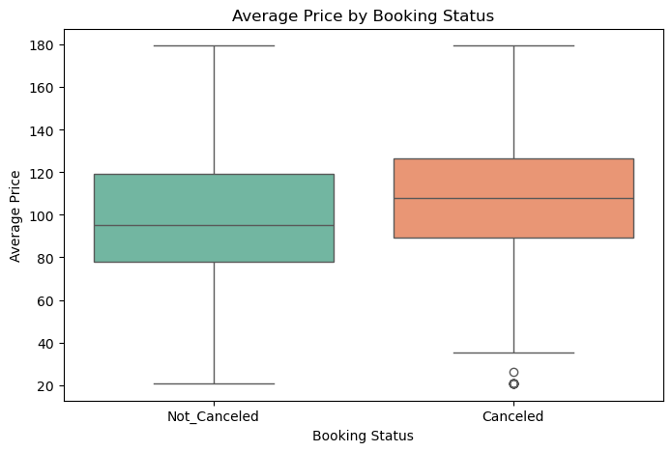
Carrying out comprehensive analysis on data set (Univariate, Bivariate and Multivariate Analysis)
*Looking for any patterns between average price and booking status
*INSIGHT: This shows that the cancelled booking status has a higher median than the not cancelled status. This shows that most customers tend to cancel bookings when prices are higher, and they do not cancel when prices are low.
*Cancelled status happened when the median price was higher i.e within the average price of 100 to 120, and the records with not cancelling were around the average price of 80 to 120.

Slide 8
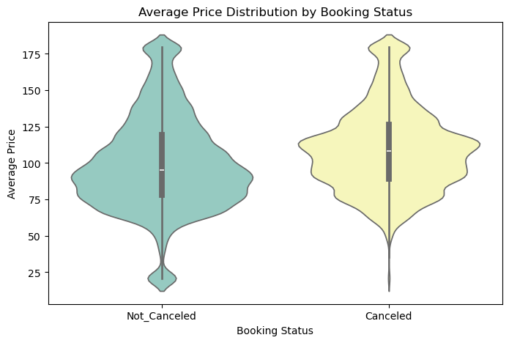
Visualizing average price against booking status
*INSIGHT: For the "Not cancelled Status": there is large concentration of people not cancelling around the average price ranges of 75 to 100. Thus, majority of customers do not cancel when the price range falls within this range. Also, there are still a few customers who do not cancel at high prices of 175.
For the "cancelled status" : the plot reveals that most customers cancelling fall around the price range of 100 and 125. Its median price is higher than that of the "not cancelled status". And also further shows that there are some customers cancelling at the very high prices as well i.e around 175.

Slide 9
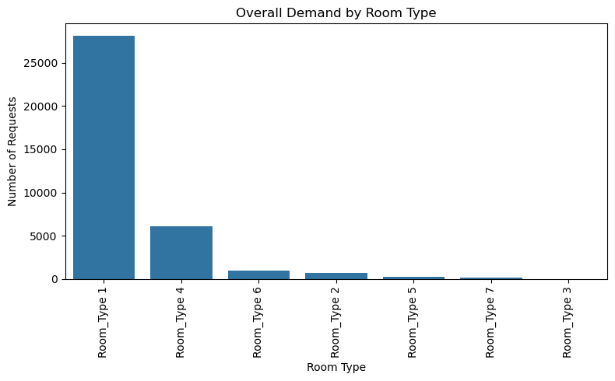
Confirming the demand on the various room types
*INSIGHT: This reveals that room type 1 was most requested, followed by room type 4. Room type 3 hardly had any requests for it.

Slide 10
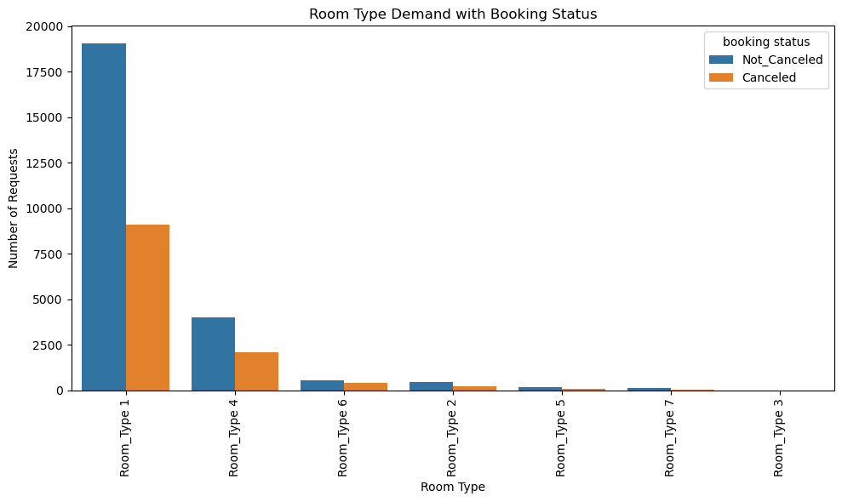
Confirming the pattern between booking status and the room type
* INSIGHT: This reveals that room type 1 had the most demand and the most retained booking.

Slide 11
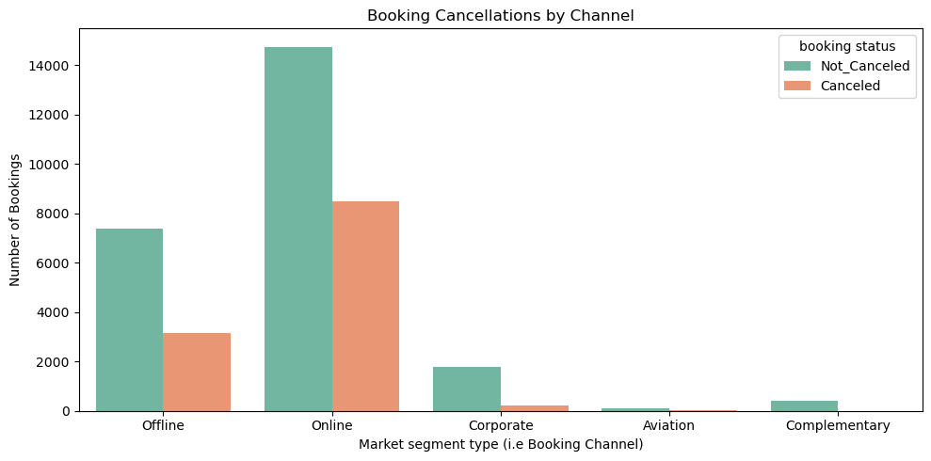
Confirming which market segment type had the most booking
INSIGHT: The online channel was the most used for booking with the highest "not cancelled booking"

Slide 12
Getting an overview of the customer segment (i.e comparison of children and adults)
*INSIGHT: Reveals that our customer segment are only adults and no children have been recorded to be in the facility.

Slide 13
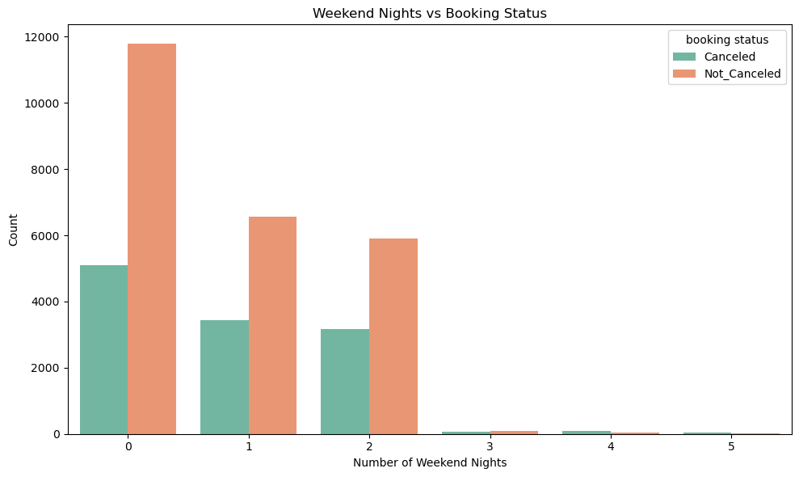
Visualising the booking pattern during weekend nights
INSIGHT: More customers who book 1 or 2 weekend nights tend to retain their booking compared to those who cancel.

Slide 14
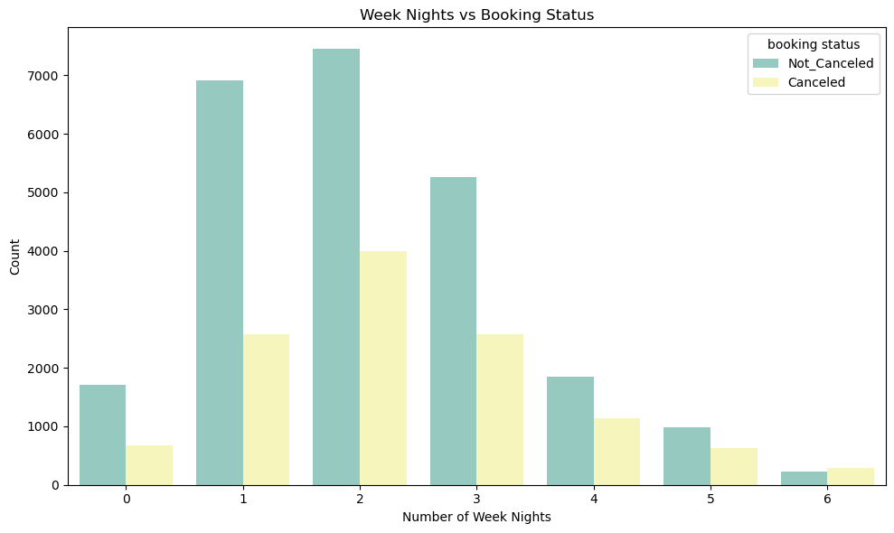
Verifying the booking pattern for week nights
INSIGHT: Majority of customers booking 1 to 3 week nights have a higher rate of not cancelling.

Slide 15
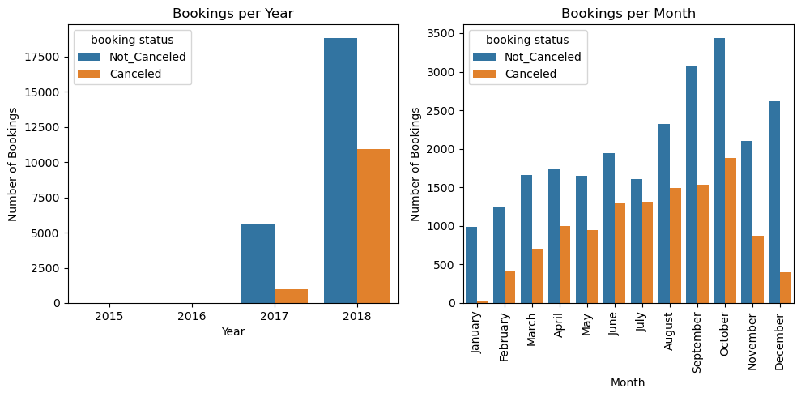
*The most booking happened in the year 2018. * There appears to be peak bookings around the months: august to december

Slide 16
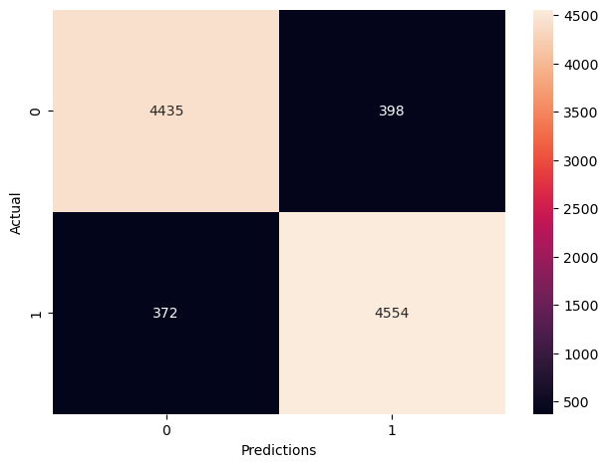
Model selection: The Random Forest Classifier Model proved to be the most efficient predictor model with an accuracy value of 92% compared to the other models used.
It predicted accurately category "0", 4445 times and inaccurately 374 times. Also, it predicted category 1 accurately 4552 times and accurately 388 times. A better performing model compared to the Logistic regression model used earlier on.

Slide 17
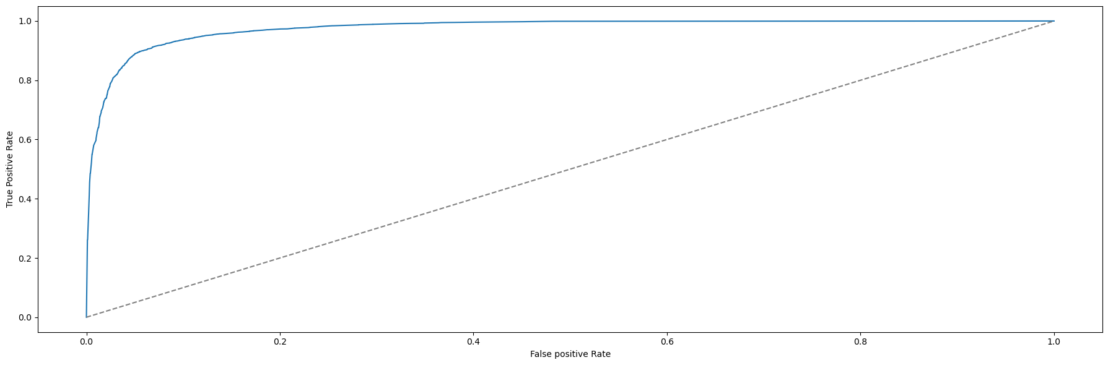
Evaluating the model's ability to distinguish between classes
INSIGHT: Since the curve is above the line, it indicates that the model is able to differentiate the classes appropriately. Therefore it has good credibility for future predictions.

Slide 18
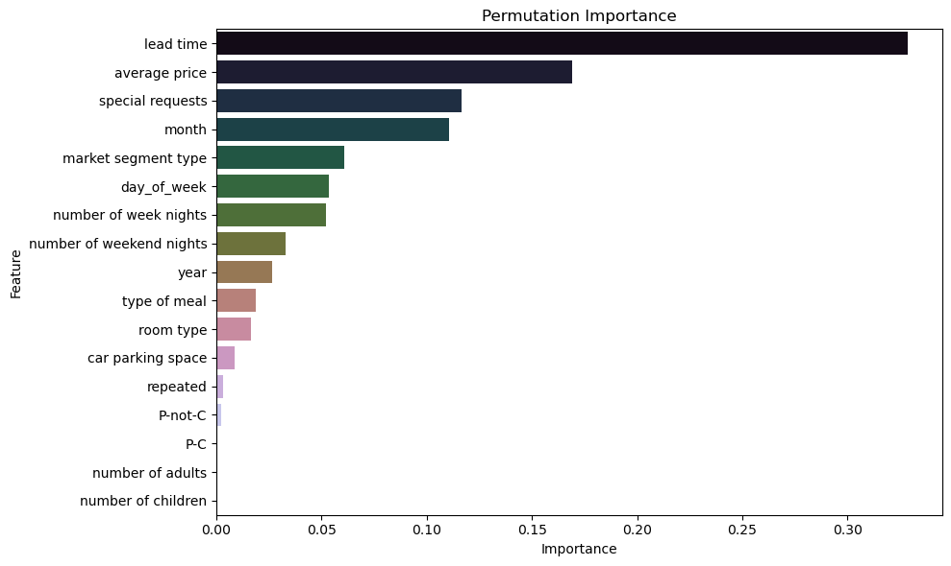
Investigating the most influencing factors to the booking behaviour of customers
INSIGHT: The plot reveals in order of importance the most influential factors to the booking patterns of customers.
Lead time (i.e time between the reservation and check-in date) is the factor with the most influence on the booking status, followed by the average price.
This will help guide the management of Hotel Haven on what to prioritise so boost its revenue and have an efficient system for allocation of resources.

Slide 19
This highlights the top five influential factors to Hotel Haven’s customers booking behaviors.
Feature | Importance
lead time | 0.328591
average price | 0.169155
special requests | 0.116392
month | 0.110602
Market Segment | 0.060608

Slide 20
Recommendations:
Since the data reveals the customer base comprises of only adults, there could be packages tailored to attract couples or families, so to increase the facility’s customer base.
Since the typical stays are usually 1 weekend night and 2 weeknights, implying short stays, the management should focus on designing packages to establish customer loyalty who mostly subscribe to these number of days.
The peak months as revealed from the data for booking mostly happened from August to December, hence more juicy and attractive packages should be designed for these season so to increase customer experience and loyalty, particularly aiming to regularize first time visitors would be beneficial to the facility’s growth.
Since parking lots are not in high demand, management should reallocate resources to other sectors to best improve customer experiences.
Also, observing the significant impact the average price has on customer’s booking behavior, management could design various price packages to accommodate customers who might be budget conscious.
Overall, based on the feature importance ranking, policies and resources should be most allocated to boosting customers experience when interfacing with at the least the top five influencing factors to customers booking behavior. (i.e lead time, average price, special requests, month, and market segment type.

